Slide 1
Evaluating Revised Tracking Metric for Regional Haze Planning
Comparing EPA estimates to CAMx PSAT for 2011
Natural vs Anthropogenic contributions to IMPROVE aerosol extinction
Pat Brewer (NPS), Gail Tonnesen (EPA Region 8), Tom Moore (WESTAR-WRAP)
April 2018

Slide 2
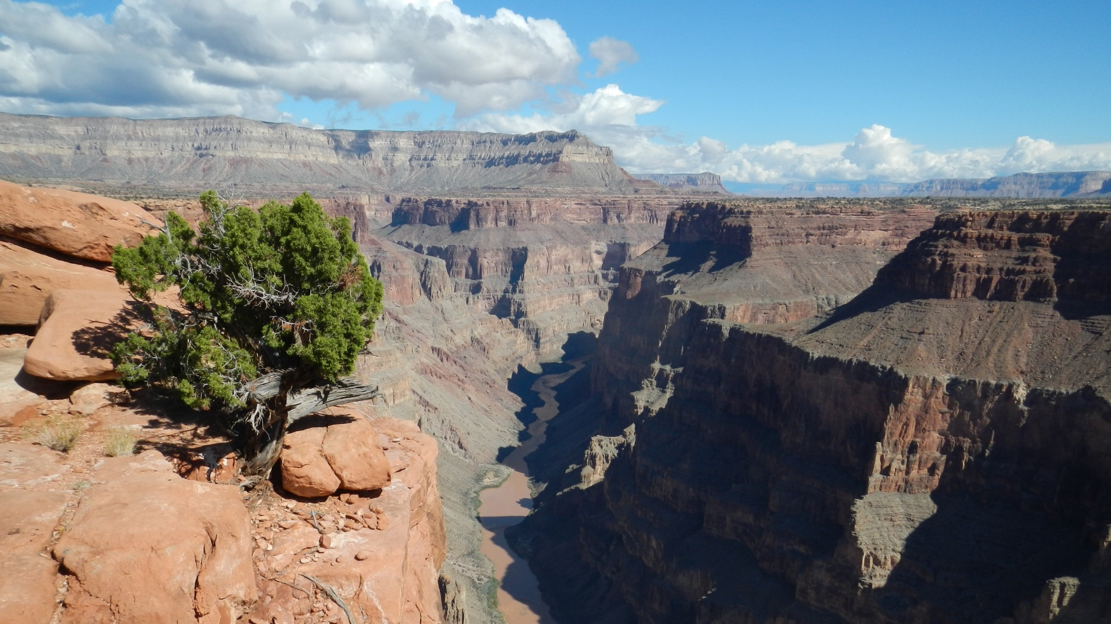
IMPROVE measured aerosol species composition and calculated light extinction are used to track visibility progress in regional haze planning.
Grand Canyon National Park
Notes:
Grand Canyon NP

Slide 3
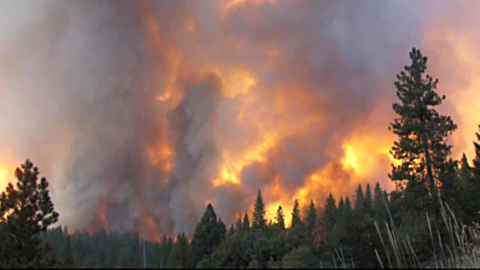
At western Class I areas haziest days can be dominated by aerosol species associated with natural wildfires or dust storms.
Yosemite National Park, 2013 Rim Fire

Slide 4
Source Contributions to IMPROVE Aerosol Data
2017 Revised RHR instructs states to track visibility progress on days with greatest anthropogenic impairment rather than overall haziest days.
EPA’s draft method to select most impaired days uses operational definitions of natural and anthropogenic contributions to IMPROVE data.
States will use regional air quality models to project future visibility improvements on the most impaired days.
Notes:
Great Basin NP

Slide 5
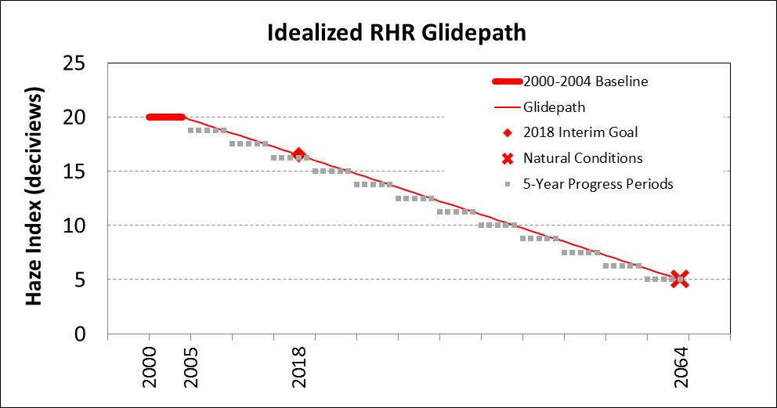
Source Contributions to IMPROVE Aerosol Data
If modeled U.S. anthropogenic contributions differ from EPA estimated total anthropogenic contributions, there can be a disconnect between modeled rate of progress and the uniform rate of progress, even if both methods are correct.
(Measured)
(Estimated)
(Estimated)
2028

Slide 6
Source Contributions to IMPROVE Aerosol Data
We compared the EPA method to CAMx PSAT for 2011 to understand strengths and weaknesses and to summarize our results relevant to western states regional haze planning.
IMPROVE data and source contributions vary spatially and temporally. 2011 results reported here may not represent future conditions.

Slide 7
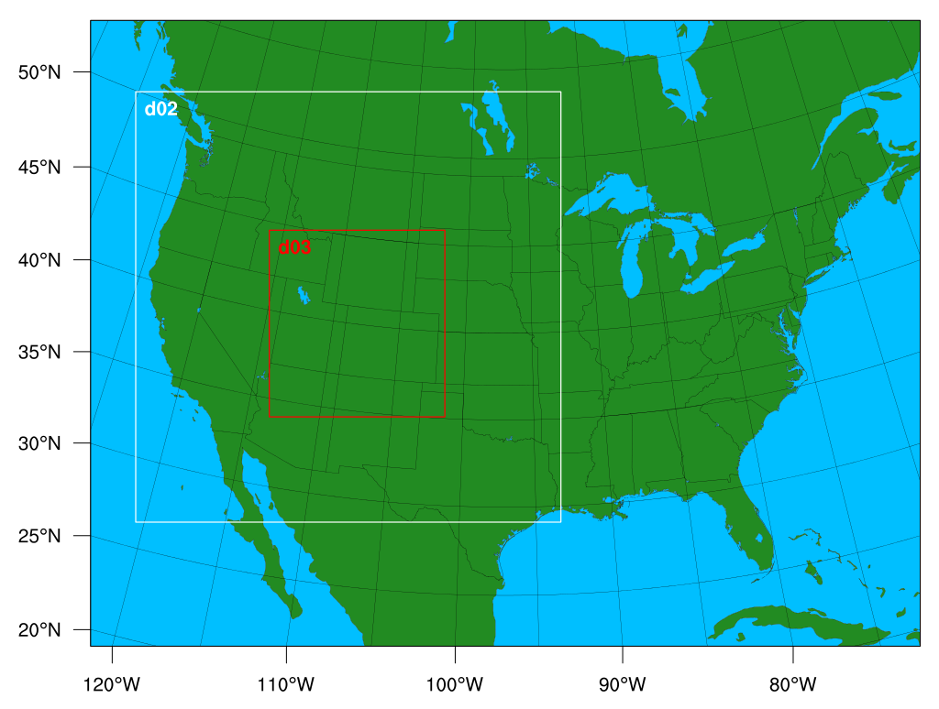
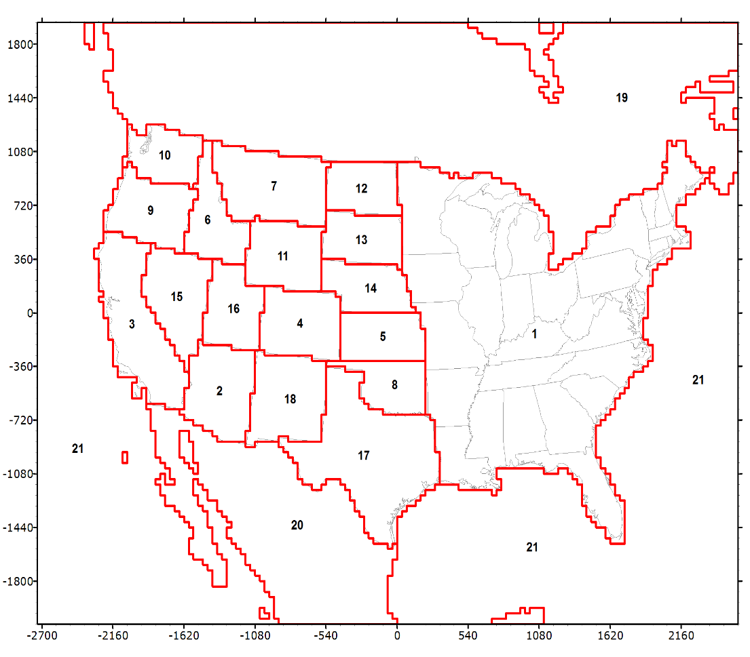
2011 Western Air Quality Study CAMx version 6.10 2011b
(a) Modeling Domain
(b) source regions for the Particle Source
Apportionment Tool (PSAT).
http://views.cira.colostate.edu/tsdw/

Slide 8
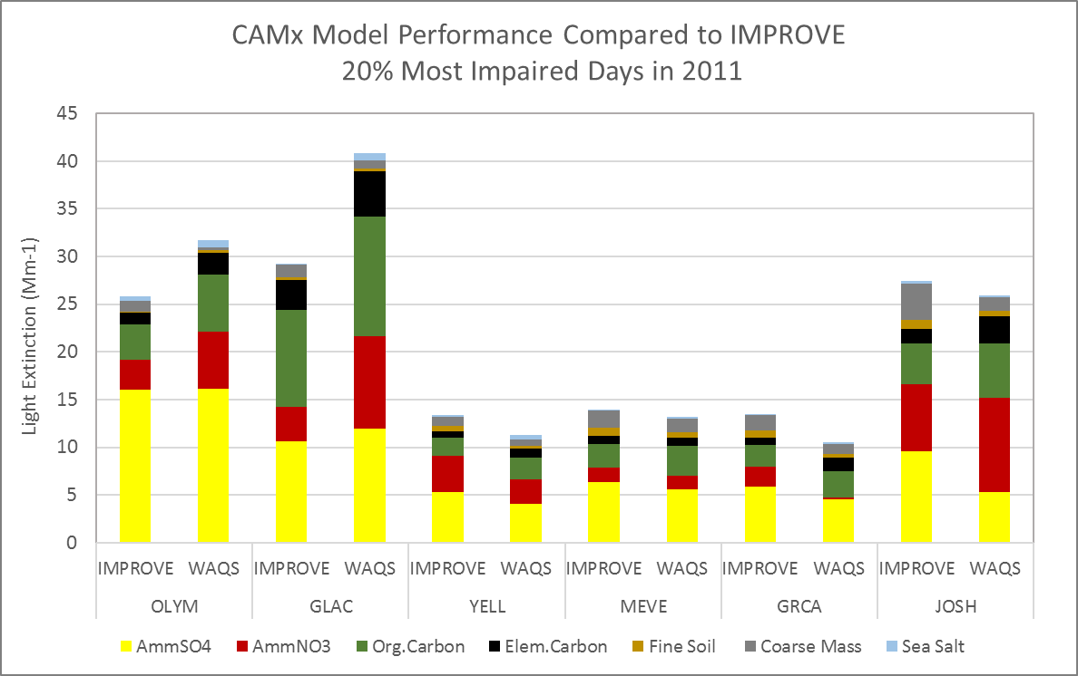
Example sites represent different geographic areas and different source contributions
Organic Mass
2011 CAMx performance is best for AmmSO4 and more variable for AmmNO3 and OM.
PSAT source contributions are applied as percentage to IMPROVE aerosol extinction

Slide 9
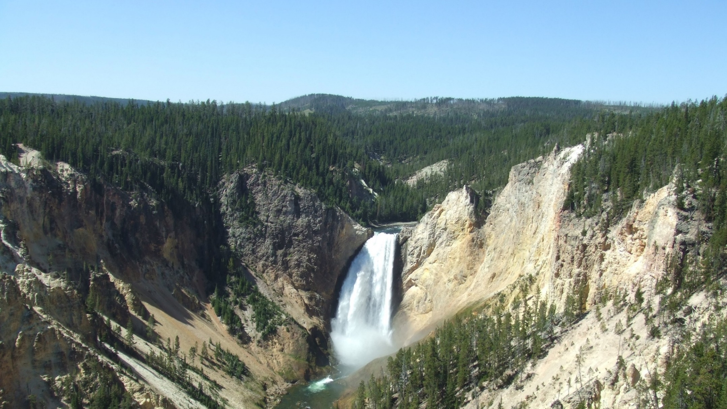
EPA draft recommended methods:
Estimated Natural and Anthropogenic Contributions to IMPROVE Aerosol Extinction
Yellowstone National Park
Notes:
Golden Gate NRA

Slide 10
For each Class I area & year of IMPROVE monitoring data:
Apply Episodic thresholds for Carbon (Organic Carbon Mass, OCM, plus Elemental Carbon, EC) and Dust (Fine Soil plus Coarse Mass)
Episodic Carbon is assumed to be from wildland fires
Episodic fine soil and coarse mass are assumed to be from dust storms
Episodic threshold is minimum 95% Carbon or Dust measurements in years 2000-2014. Values greater than the minimum year 95% tile are assumed to be episodic natural events.
Calculate daily routine natural light extinction for each aerosol species
Divide annual average natural (Natural Conditions II, IMPROVE 2007) by the annual average of the non-episodic measured IMPROVE data to calculate fraction of routine natural
Multiply the daily non-episodic IMPROVE extinction for each aerosol species by annual average routine natural fraction from (a) above
Fraction of routine natural varies for each species and each year, but within a year, the same fraction is applied every day.
All sea salt is natural
For every other aerosol species:
Anthropogenic extinction = Total aerosol species extinction – episodic (if OC, EC, fine soil or coarse mass) – routine natural

Slide 11
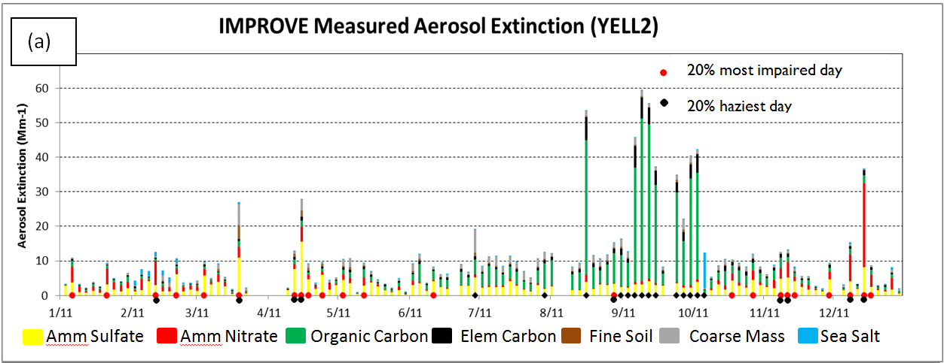
Most Impaired Days vs. Haziest Days Metrics
Yellowstone National Park, 2011:
Haziest days are dominated by wildfire, most impaired days ≠ haziest days
Organic Mass
Most Impaired
Haziest
Most Impaired
Notes:
.

Slide 12
Days with highest aerosol haze:
dominated by carbon (+1 day with high nitrate)
IMPROVE by Haziest Day: Yellowstone NP, 2011
Total Extinction calculated directly from IMPROVE data.
No estimate of natural and anthropogenic contributions.
Haziest

Slide 13
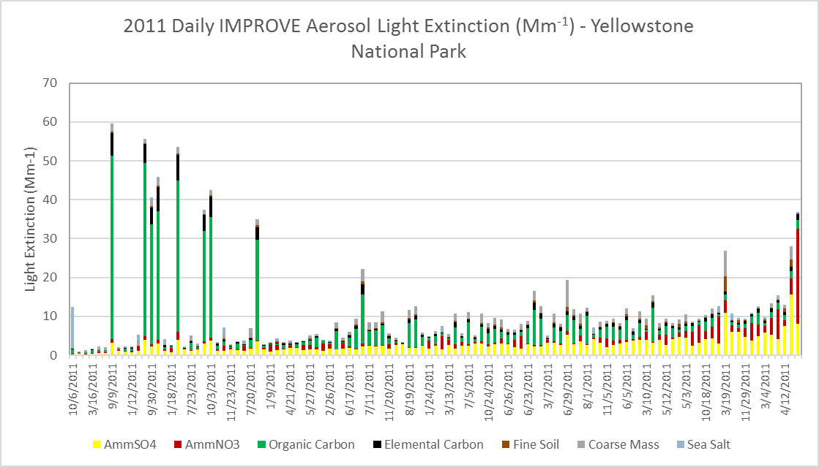
Nitrate and sulfate ➔ most impaired days. High carbon ≠ most impaired days.
2011 IMPROVE days sorted by impairment - Yellowstone National Park
IMPROVE by Impairment: Yellowstone NP, 2011
Impairment calculated using the EPA estimate of natural and anthropogenic contributions to IMPROVE data
Organic Mass
Most Impaired

Slide 14
Glacier NP, 2011: More overlap between most impaired days and haziest days than Yellowstone NP.
Some days are both haziest & most impaired days
20% most impaired day
20% haziest day
Haziest days
Most impaired days
Amm Sulfate Amm Nitrate Organic Mass Elem Carbon Fine Soil Coarse Mass Sea Salt

Slide 15
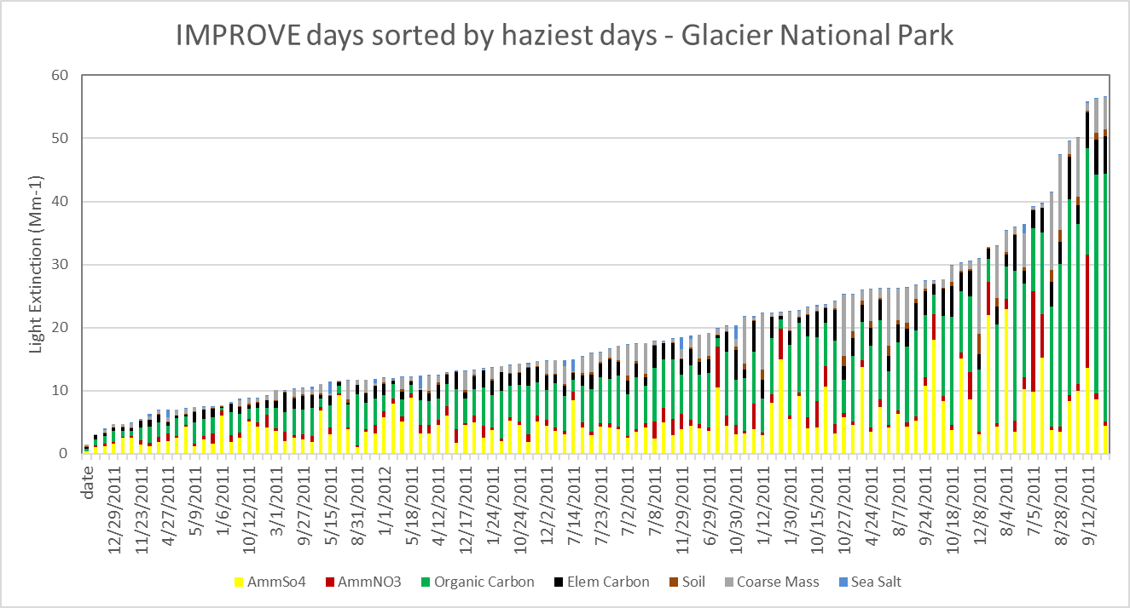
Glacier NP, 2011: haziest days dominated by carbon, sulfate, and nitrate.
Organic Mass
Haziest

Slide 16
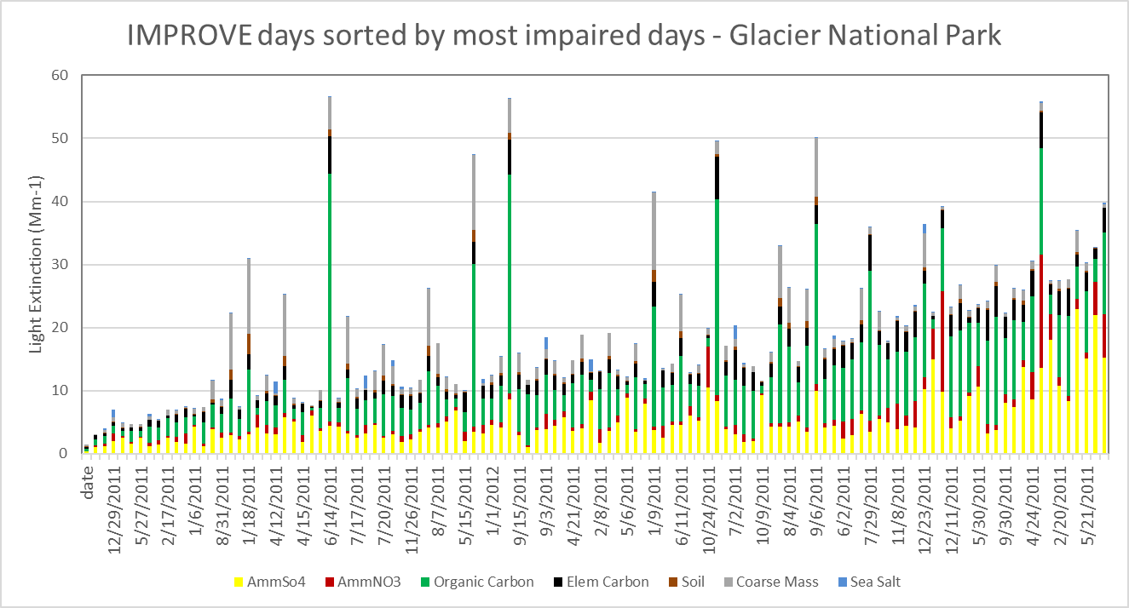
Glacier NP, 2011: impaired days dominated by sulfate, carbon, and nitrate.
.
Organic Mass
Most Impaired

Slide 17
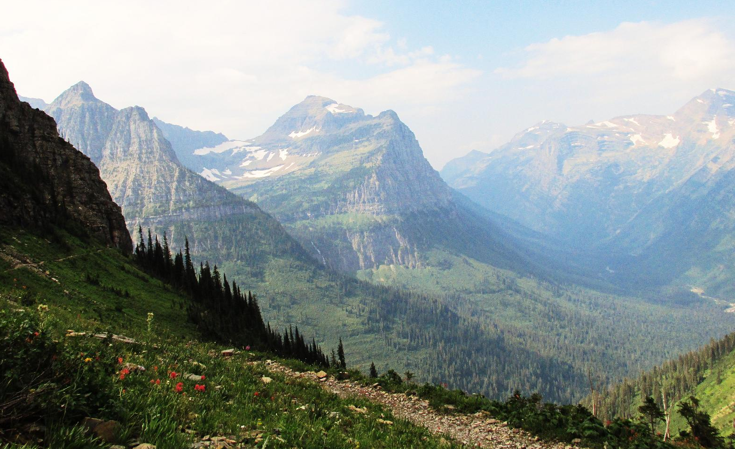
Up Next: Comparison of EPA method to PSAT for Organic Mass extinction at Yellowstone and Glacier National Parks
Glacier National Park
Notes:
Yellowstone NP

Slide 18
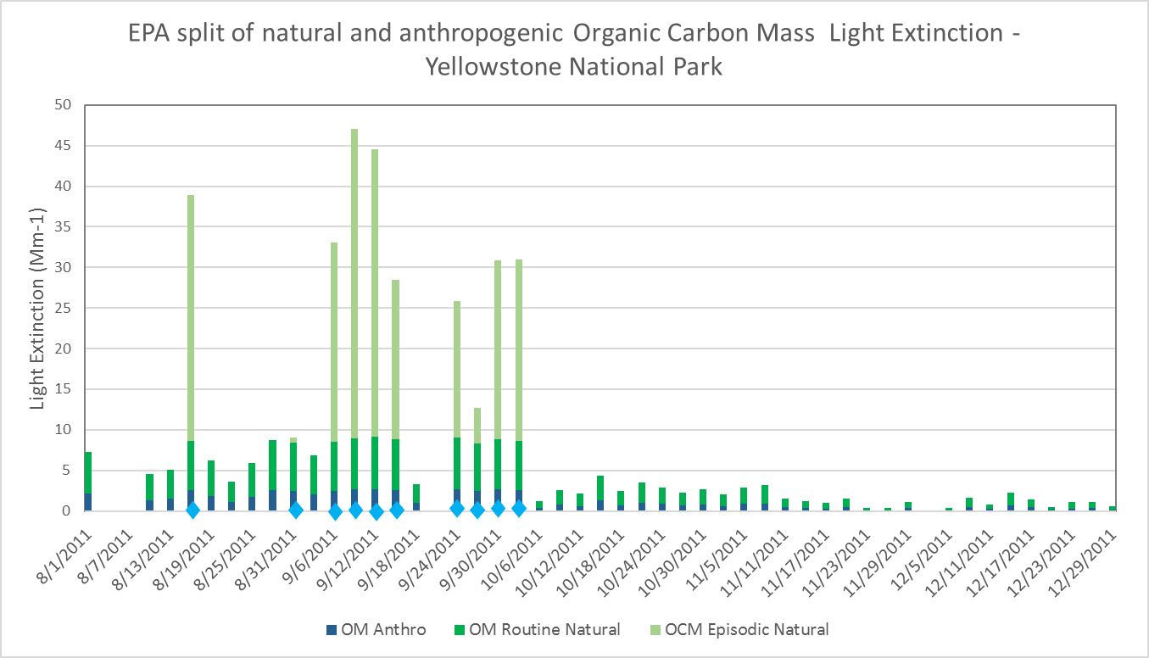
EPA method estimates:
episodic natural, routine natural, and anthropogenic contributions to Organic Mass
Episodic carbon threshold exceeded
Carbon episodic threshold (C3) = 10.1 Mm⁻¹ at YELL
Organic Mass threshold (OM3) = C3 * OM/(OM+EC)
Non-Episodic Natural OM = OM – OM3
Routine Natural OM = non-episodic OM * (ann ave NCII OM/ann ave OM)
Anthro OM = Non-episodic OM – Routine Natural OM
OM Episodic Natural

Slide 19
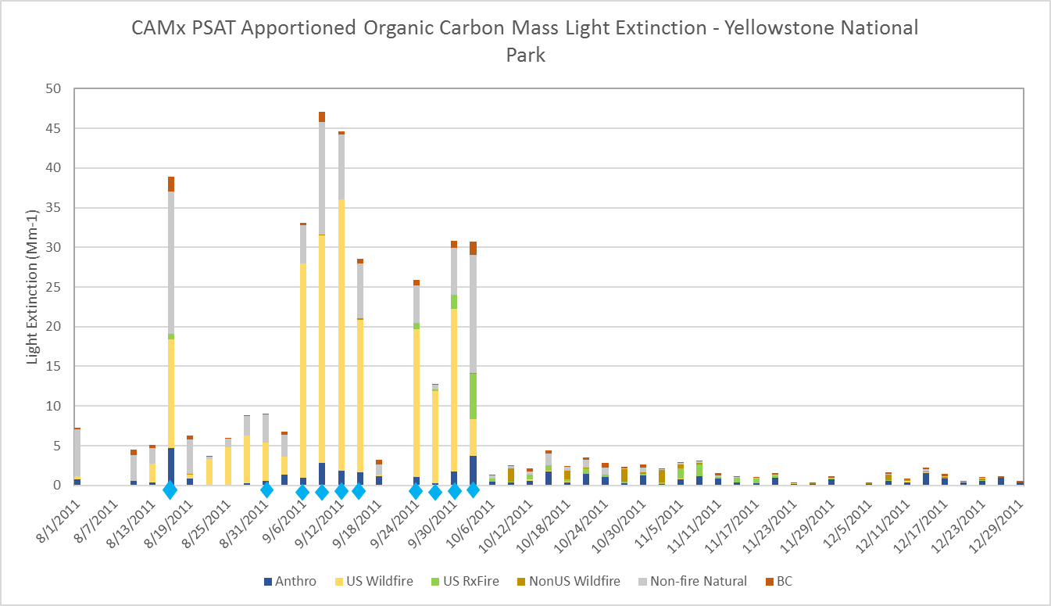
CAMx PSAT tags emissions by source category and geographic area.
PSAT tags:
U.S. Natural
Non-U.S. Natural
U.S. Wildfire
U.S. Prescribed fire
Non-U.S. wildland fire
U.S. Agricultural Fire
U.S. Anthro
Non-U.S. Ag Fire
Non-U.S. Anthro
Boundary Conditions
Initial Conditions
Episodic carbon threshold exceeded
Note: CAMx PSAT source contributions are modeled percentages applied to IMPROVE measurements.

Slide 20
Episodic carbon threshold exceeded
At Yellowstone NP: good match
between EPA assignment
of episodic and routine natural
and PSAT
OM Episodic Natural
Episodic carbon threshold exceeded

Slide 21
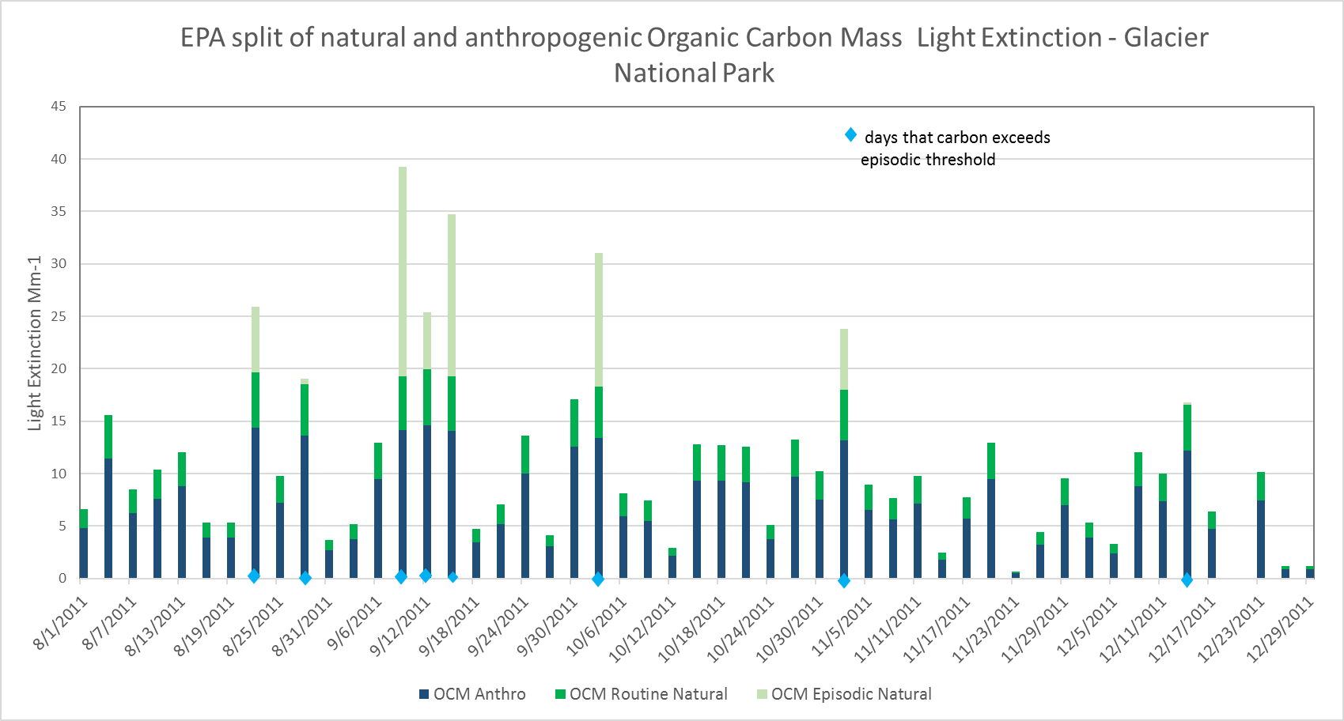
Yellowstone National Park
Episodic carbon threshold:
higher for Glacier NP (22.2 Mm⁻¹) than for Yellowstone NP (10.1 Mm⁻¹).
Fraction of non-episodic OM that is
assigned as routine natural:
smaller for Glacier NP than for Yellowstone NP.
Less OM assigned as episodic
natural and routine natural, and
more OM assigned as anthropogenic at Glacier NP than at Yellowstone.
Episodic carbon threshold exceeded
OM Episodic Natural
Glacier National Park
Episodic carbon threshold exceeded
OM Episodic Natural

Slide 22
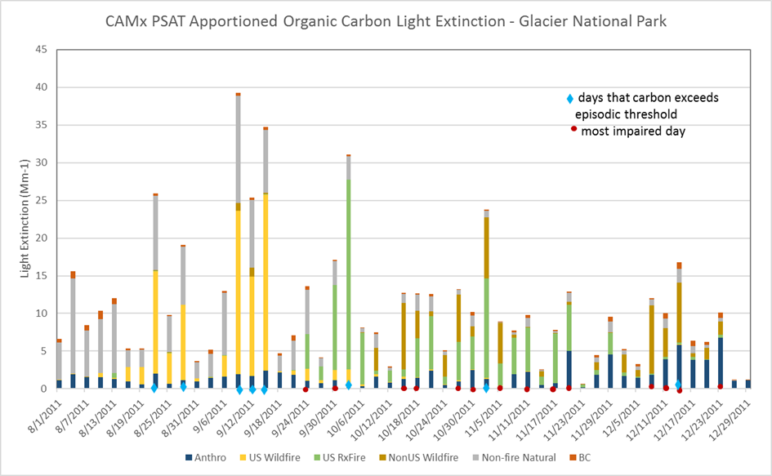
At Glacier NP, 2011
EPA split assigns more OM as anthropogenic, especially in October & November.
PSAT identifies OM in
August as biogenic natural
September as primarily U.S. wildfire
October & November as U.S. prescribed fire and Canadian wildfire.
For most western Class I areas in 2011, EPA split for OM was similar to PSAT source apportionment.
Glacier NP was an exception in 2011.
OM Episodic Natural

Slide 23
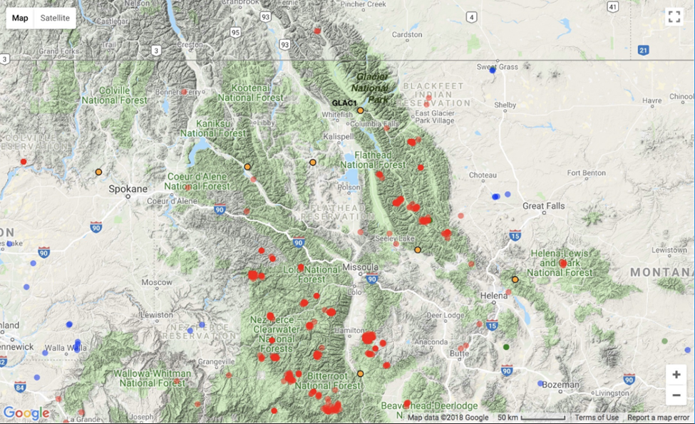
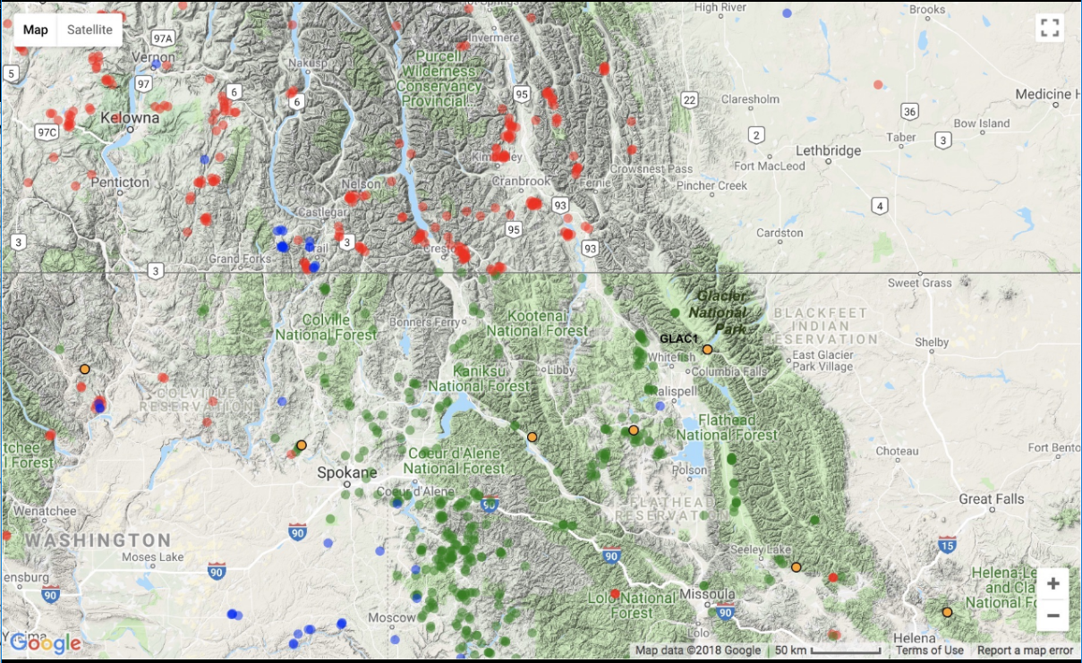
Fire activity data confirm fire events on days exceeding EPA’s episodic carbon threshold
IMPROVE monitor location at Glacier National Park
Wildfires (red circles) and agricultural fires (blue circles) near Glacier NP from 9/9 to 9/15/2011
b) Prescribed fires (green circles), wildfires (red circles),
and agricultural fires (blue circles) near Glacier NP
from 10/31 to 11/2/2011
www.wraptools.org

Slide 24
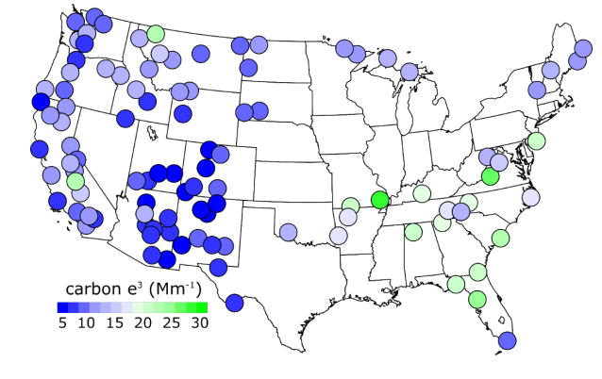
EPA’s carbon threshold generally shows good performance compared to PSAT
Glacier NP is an example where higher episodic carbon threshold and extended fire season suggest EPA method may have underestimated fire smoke impacts.
EPA episodic threshold uses year with minimum 95% for carbon or dust for years 2000-2014.
At sites with extensive fire activity every year, state might consider whether using lower threshold than 95% would better capture fire activity. PSAT results are currently available only for 2011.
Map from 2016 EPA draft Technical Support Document for Revised Visibility Tracking Metric

Slide 25
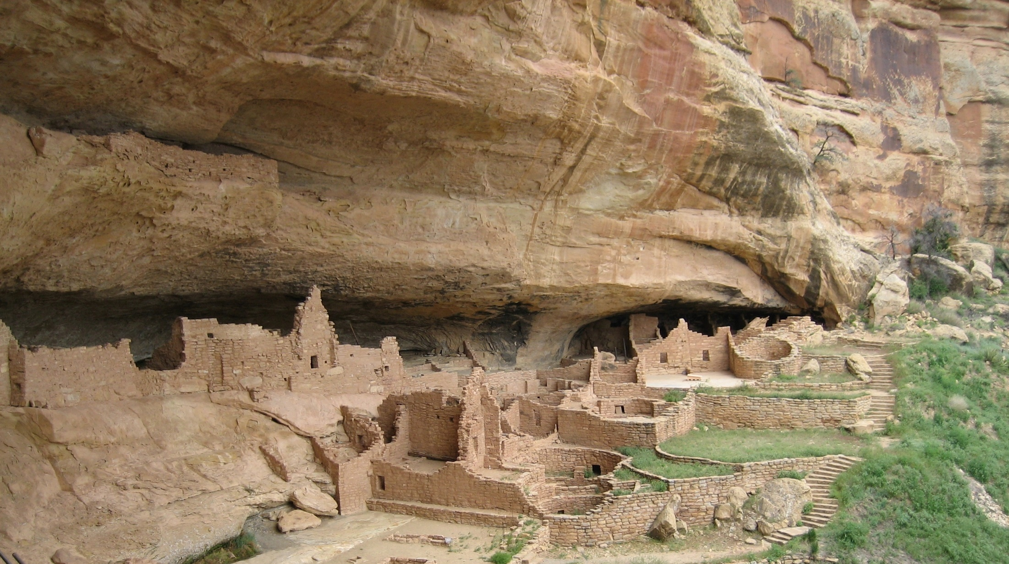
What about other aerosol species?
Mesa Verde National Park
Notes:
Mesa Verde NP

Slide 26
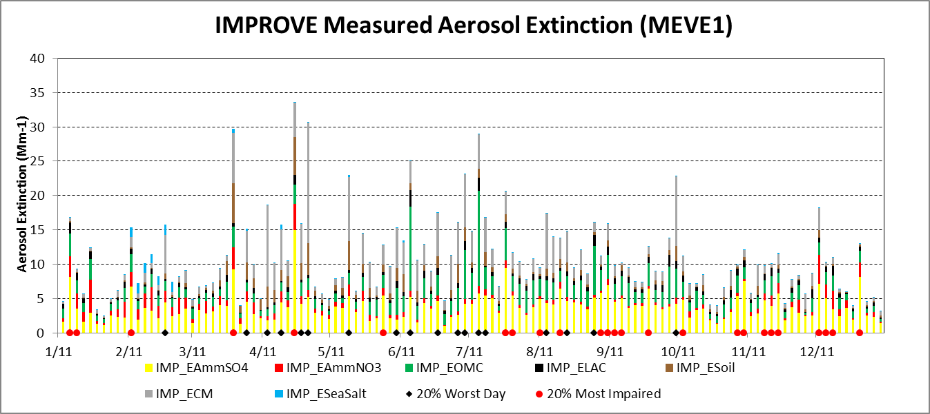
Mesa Verde NP, 2011: haziest days are dominated by carbon & dust.
Haziest days
Most impaired days
Amm Sulfate Amm Nitrate Organic Mass Elem Carbon Fine Soil Coarse Mass Sea Salt
Haziest
Most Impaired
Notes:
Max April day has large modeled background haze

Slide 27
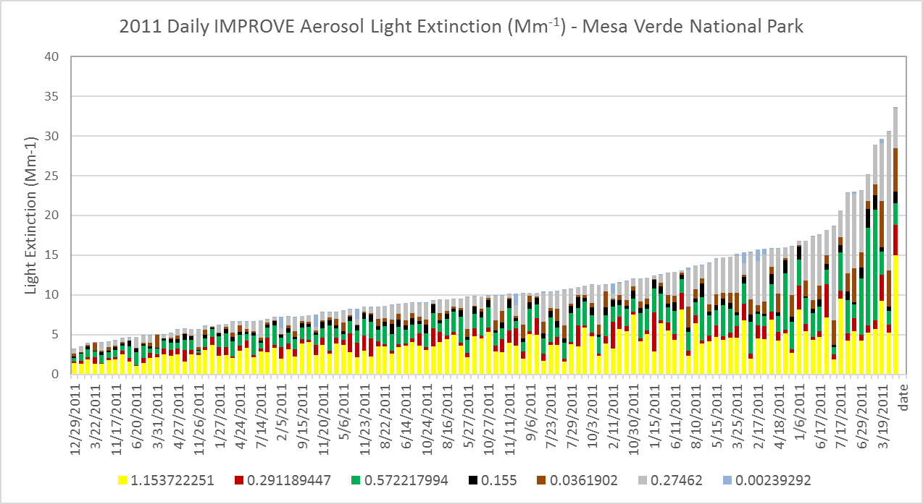
Mesa Verde NP, 2011: haziest days are dominated by sulfate, carbon, or & dust.
IMPROVE by Haziest Day: Mesa Verde NP, 2011
Amm Sulfate Amm Nitrate Organic Mass Elem Carbon Fine Soil Coarse Mass Sea Salt
Haziest

Slide 28
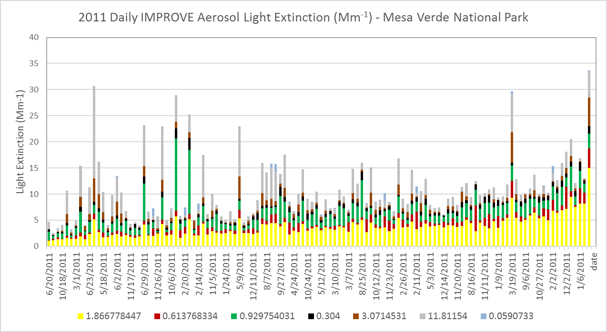
Mesa Verde NP, 2011: impaired days dominated by sulfate. A few haziest days with high dust are also most impaired.
IMPROVE by Impairment: Mesa Verde NP, 2011
Most impaired
Days can still have a large fraction assigned as “natural”.
Amm Sulfate Amm Nitrate Organic Mass Elem Carbon Fine Soil Coarse Mass Sea Salt
Most Impaired

Slide 29
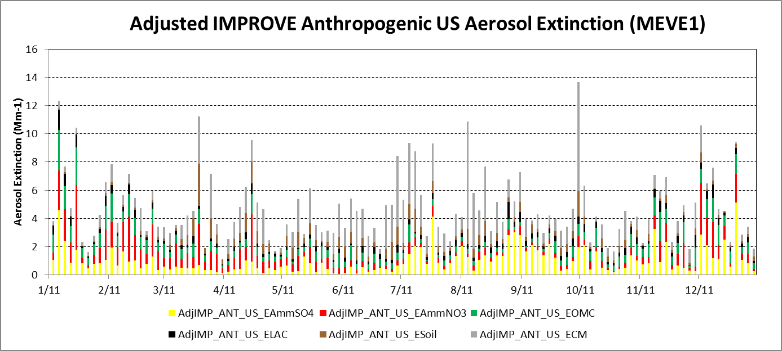
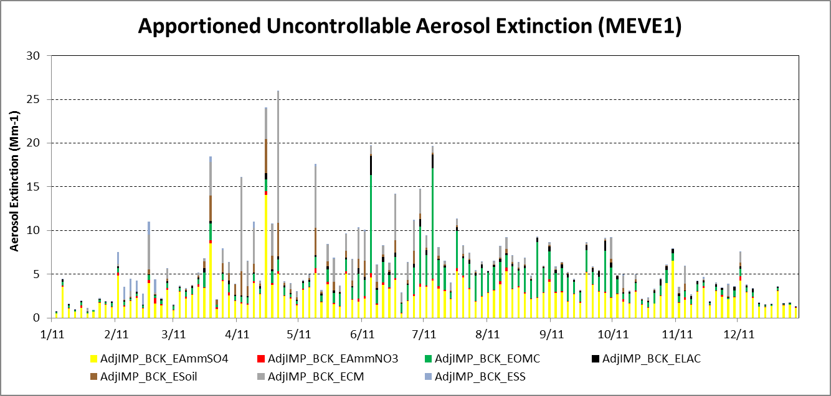
CAMx PSAT Apportioned U.S. Anthropogenic Aerosol Extinction – Mesa Verde
CAMx overestimates anthropogenic contributions to dust, so difficult to assess EPA dust threshold.
PSAT attributes large fractions of AmmNO3 and dust to U.S. anthropogenic emissions. Some uncertainty due to PSAT method to tag NO3 at the boundary between the global and regional models.
Amm Sulfate Amm Nitrate Organic Mass Elem Carbon Fine Soil Coarse Mass
CAMx PSAT Apportioned U.S. Background Aerosol Extinction – Mesa Verde
PSAT attributes large fractions of AmmSO4 and OM to international and natural emissions, respectively.
Amm Sulfate Amm Nitrate Organic Mass Elem Carbon Fine Soil Coarse Mass

Slide 30
Joshua Tree NP, 2011: most overlap between haziest days & most impaired days.
IMPROVE by Sample Date: Joshua Tree NP, 2011
Haziest days
Most impaired days
Amm Sulfate Amm Nitrate Organic Mass Elem Carbon Fine Soil Coarse Mass Sea Salt

Slide 31
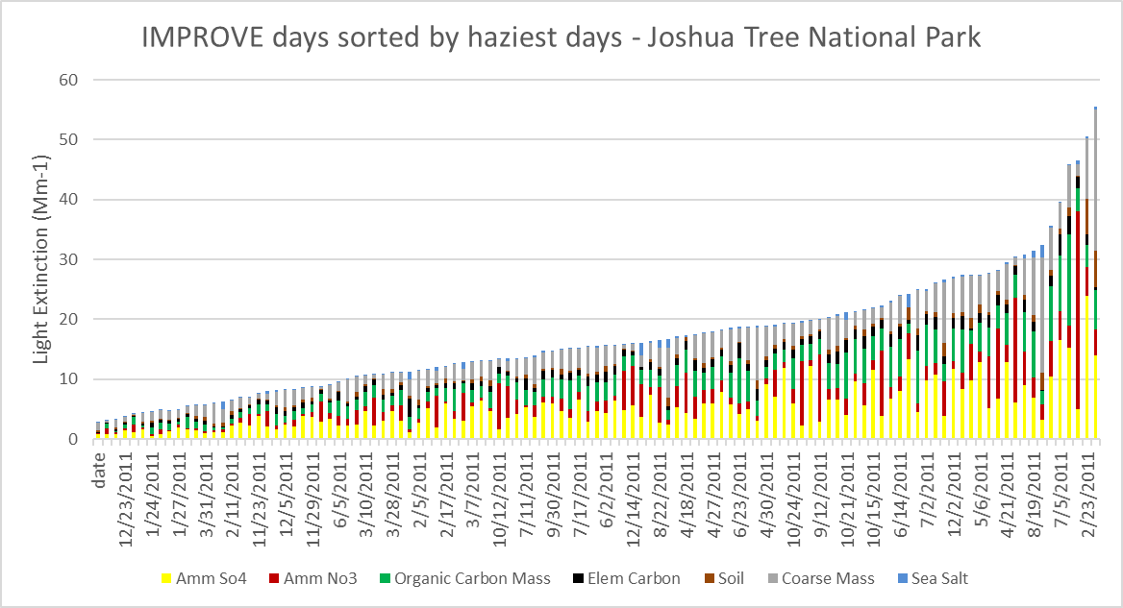
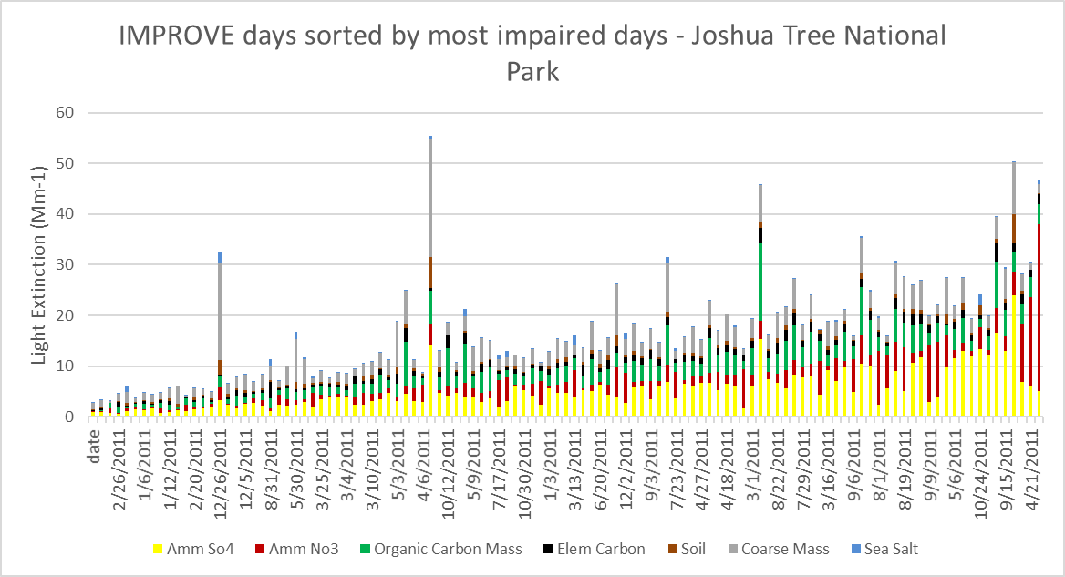
IMPROVE by Haziest Day: Joshua Tree NP, 2011
At JOSH, both haziest days and most impaired days dominated by AmmNO3 and AmmSO4.
Days with highest dust not most impaired days.
Haziest
IMPROVE by Impairment: Joshua Tree NP, 2011
Most Impaired

Slide 32
CAMx PSAT Apportioned U.S. Anthropogenic Aerosol Extinction – Joshua Tree
Uncertainty in PSAT assignment of most AmmNO3 to U.S. anthro and most AmmSO4 to non-U.S.
Contributions.
Outcome dependent on accuracy of international emissions, global transport, and PSAT tagging.
Model might be more accurate for changes in impairment from U.S. anthropogenic emissions reductions between base year and future year
Amm Sulfate Amm Nitrate Organic Mass Elem Carbon Fine Soil Coarse Mass
CAMx PSAT Apportioned U.S. Background Aerosol Extinction –Joshua Tree
Amm Sulfate Amm Nitrate Organic Mass Elem Carbon Fine Soil Coarse Mass

Slide 33
Summary: Natural vs Anthropogenic Contributions
Uncertainty in both EPA method and CAMx PSAT
Across sites, EPA method tends to select days with highest fractions of ammonium sulfate and ammonium nitrate as most impaired days
However EPA’s source estimates are not directly linked to specific emissions; for state planning purposes, air quality models are used to define which specific emission sources are contributing on most impaired days.
For most impaired days at many western Class I areas, PSAT apportions
More of ammonium sulfate to international than U.S. anthropogenic emissions
More of ammonium nitrate to U.S. anthropogenic than international emissions
More carbon to natural than anthropogenic
More dust to anthropogenic than natural

Slide 34
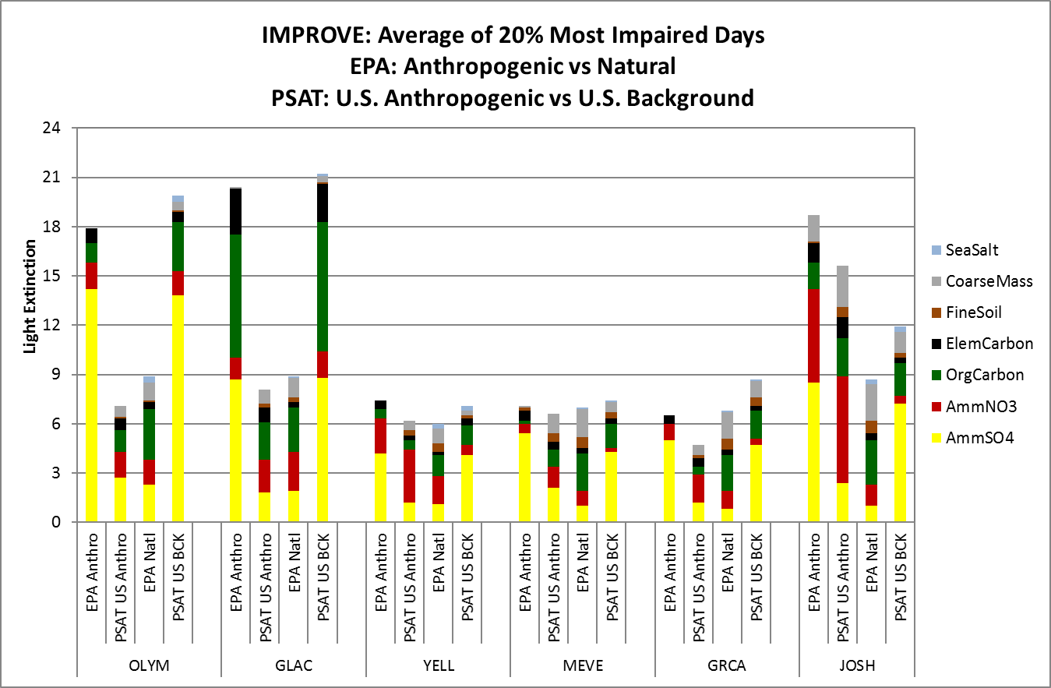
Natural vs anthropogenic contributions to IMPROVE aerosol extinction
PSAT modeled U.S. background and U.S. anthropogenic are not directly comparable to the EPA anthropogenic because current global models used for boundary conditions for regional models do not separate anthropogenic from natural emissions.
PSAT U.S. Background is the sum of natural plus international anthropogenic contributions.
CAMx PSAT source contributions are modeled percentages applied to IMPROVE measurements.

Slide 35
Next Steps: Natural vs Anthropogenic Contributions
Future WRAP Regional Haze modeling needs to separately track international anthropogenic and natural emissions to be more consistent with EPA method.
Consider options to track U.S. anthropogenic progress without international influence
Could define visibility benefit using change in modeled U.S. anthropogenic contributions between base year and future year
Could consider adjust 2064 endpoint to account for international influence
Sensitivity or source apportionment analyses can be used to rank states or sectors to determine where to focus attention
Notes:
Sequoia NP

Slide 36
Conclusions
For evaluating benefits of U.S. emissions reductions in the western U.S., tracking most impaired days is better than tracking haziest days
Days with large wildfires or dust storms are excluded from the 20% most impaired days.
The most impaired metric includes days with greater contributions from U.S. anthropogenic sources, and these days will be more responsive to U.S. emission reductions and will show greater progress in reduced impairment.
Additional global model simulations are needed to apportion boundary conditions to natural and international anthropogenic contributions:
This will allow direct comparison of the EPA estimates of natural to modeled natural conditions, and direct comparisons of EPA estimates of anthropogenic impairment to modeled U.S. and international anthropogenic impairment.
This will also allow the URP to be adjusted to account for international anthropogenic emissions so that progress can be estimated in reducing U.S. impairment.
Notes:
Rocky Mountain NP

Slide 37
Conclusions
In 2011, EPA’s estimates of natural contributions to carbon were generally consistent with PSAT estimates.
However, for sites that frequently have extended periods of wildfire smoke, states may want to further evaluate different thresholds for episodic events than 95th percentile.
Additional review of routine natural conditions could improve on Natural Conditions assumptions.
States will still need public outreach to clarify that natural sources such as wildland fire smoke and dust can cause poor visibility in Class I areas, but are largely uncontrollable.
The impairment metric will help states to communicating to the public the goals and progress of the regional haze program, i.e., improving visibility on days with U.S. impairment.
If fire and dust impacts increase, there may be more poor visibility days in the future caused by uncontrollable sources.
Visitor experience is subjective and difficult to relate to 24-hour average IMPROVE measurements made every third day.

Slide 38
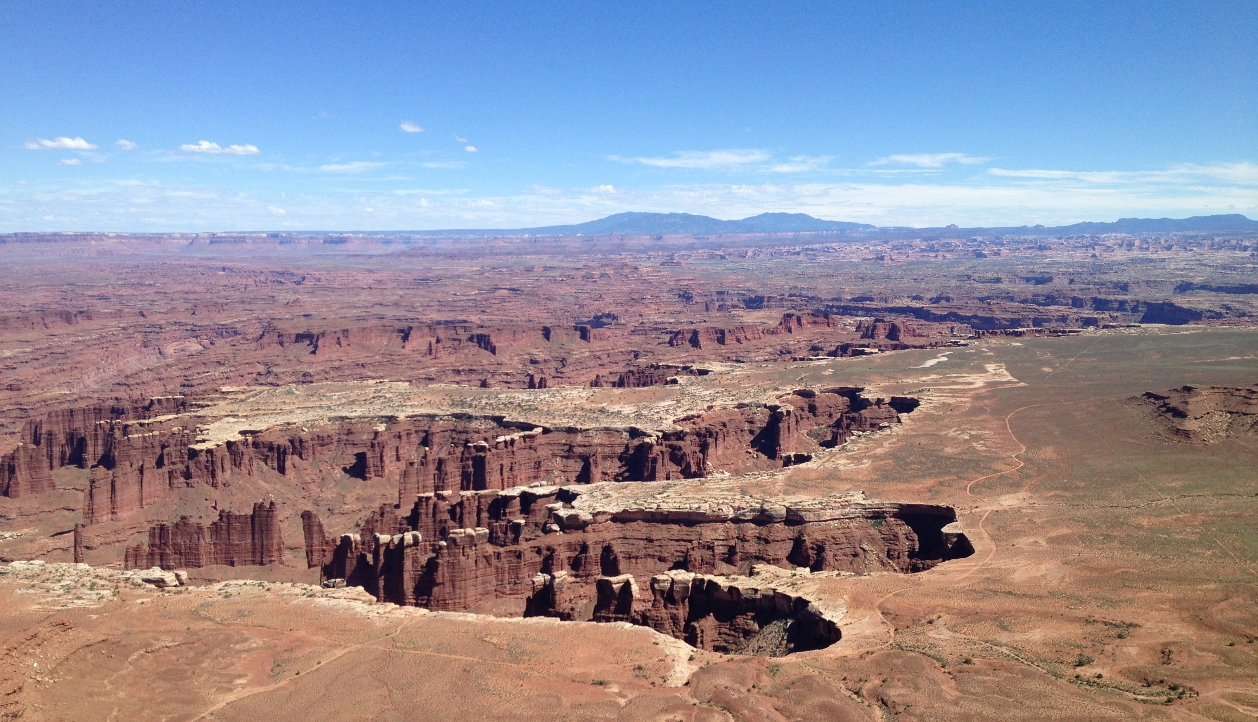
Questions?
Canyonlands National Park
Notes:
Mesa Verde NP

